Slide 1
Mudra and its effect

Slide 2
CONCEPT of mudra
A mudra is a gesture or seal used in yoga. The practice of these gestures and seals channel the flow of prana life force. They can also provide adequate blood flow to the body.
There are many mudras. They are categorized as
hand (hasta) mudras,
body (kaya) and
consciousness (citta) mudras.
We commonly use hand mudras.
Mudra strengthen the vital glands and nerves of the body.

Slide 3
Ayurveda and Mudras
Ayurveda explains the body as being made up of five elements; fire, air, space, earth and water. A healthy body has a balance of these elements. Conversely, a dominating or weakening element would cause an imbalance in the body and have a negative impact on one’s health. This would express as illness or disease.
There are five elements and five fingers. Each finger represents an according element. In yoga philosophy, it is said that through each finger, runs the prana for each element. By manipulating the pranas we can increase or decrease the prana to a specific part of the body. That is why a mudra is also referred to as a seal. We are sealing or locking the pranas for a specific purpose.

Slide 4
When a specific mudra is used for a specific purpose, it can help restore the balance of the five elements of the body using prana.
The fingers represent, accordingly, each element:
The Thumb - represents the fire element
The Index finger - represents the air element
The Middle finger - represents the space element
The Ring finger - represents the earth element
The SMALL finger - represents the water element

Slide 5
The Five Pranas
Apana – the force required for excretion,
Samana – the force required for digestion and metabolism.
Prana – the force required for the heart to pump.
Vyana – the force required circulation and movement.
Udana – the force required for upper body actions like talking, thinking, eye movement, etc.

Slide 6
Yoga Mudras
Mudras function as a unifying force to bring together and balance the body through the hands.
As we have two hands, so do we have two sides of the body; solar energy on the right side and lunar energy on the left side. The Gyana Mudra, for example, connects the right solar prana via the Pingala Nadi to the left lunar energy via the Ida Nadi. Mudras work to singularly stimulate solar or lunar energy too.
Apart from balancing energies in the body, mudras are also used in meditation and yoga practice to enhance focus and help direct our awareness inwards.
There are many mudras for meditation and yoga, each with its own unique purpose and benefit for the mind, body and spirit. Some of the most widely practiced hand mudras for meditation and yoga include Namaskar Mudra, Chin Mudra, Gyana Mudra and Vayu Mudra.

Slide 7
Mudra – Types
Namaskar Mudra
In this mudra we join the palms and fingers together in a prayer position in front of your heart. This mudra joins elements together and balances both sides of the body. It invokes the feeling of calmness and compassion and that is why we use it often in meditation.

Slide 8
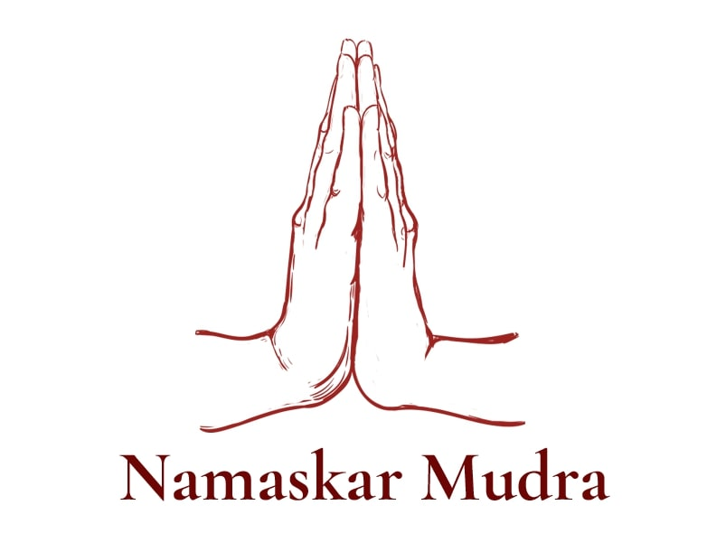

Slide 9
Chin Mudra
This is one of the most commonly practiced mudras in meditation. It is the mudra for wisdom. It involves connecting the thumb and index finger with the palms on the knees and palms facing up. Imagine holding a sheet of paper in between the fingers to get an idea of the gentle pressure to be applied between the fingers in this mudra.
In pranayama and meditation, this powerful mudra helps build concentration and heighten one’s internal awareness. We use this mudra during the day as the fingers and palms face toward the sun’s energy.

Slide 10
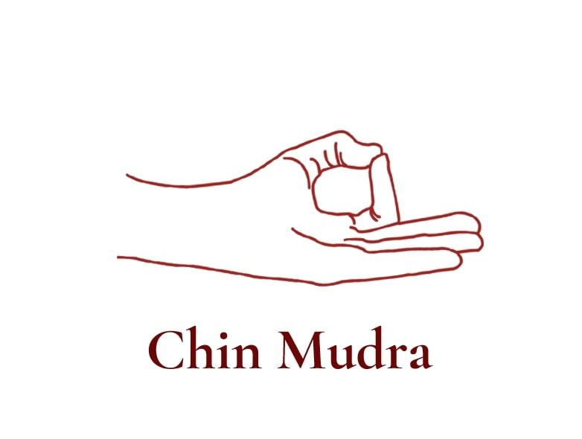

Slide 11
3. Gyana (Jnana Mudra)
The positioning of the fingers is like Chin Mudra but with the palms and fingers facing downward. When the sun is up, we use Chin Mudra to receive the energy of the sun. When the sun has set, we use Gyana Mudra with palms facing downward as we keep the sun’s energy we have received during the day. This mudra has the same benefits as Chin Mudra, such as helping to gain focus and internal awareness.
In this mudra we bring the thumb fire element and index air element together to burn the air and decrease vata (air) energy, helping us to concentrate better. To explain further, too much of the air element disturbs the mind. Decreasing the air element using the fire element helps to decreases mental disturbances. This is very powerful and effective in cases of mental ailments and sleeplessness [insomnia]. It also imparts happiness, develops the intellect, sharpens your memory, and concentration powers.

Slide 12
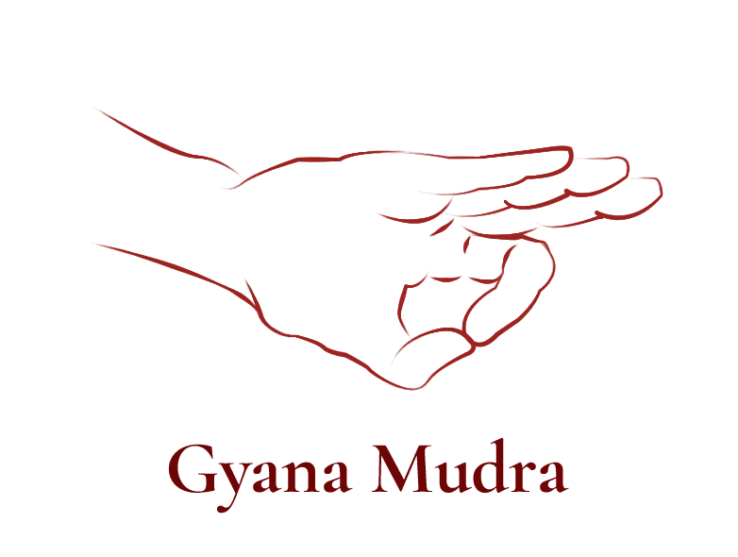

Slide 13
4. Vayu Mudra
This mudra is created by folding index finger into the base of the thumb then crossing thumb over the index finger.
This mudra is not to be confused with Chin Mudra. They are similar in their positioning of the hands and effect however, in Vayu Mudra we use it to vastly decrease the vayu air element. If the air element dominates the body, for example too much stress or anxiety issues, skin infections or much air in the intestine, one should use this mudra. This mudra is useful in ailments such as arthritis, Parkinson’s disease, polio, and paralysis. For better results, practice it after prana mudra.

Slide 14
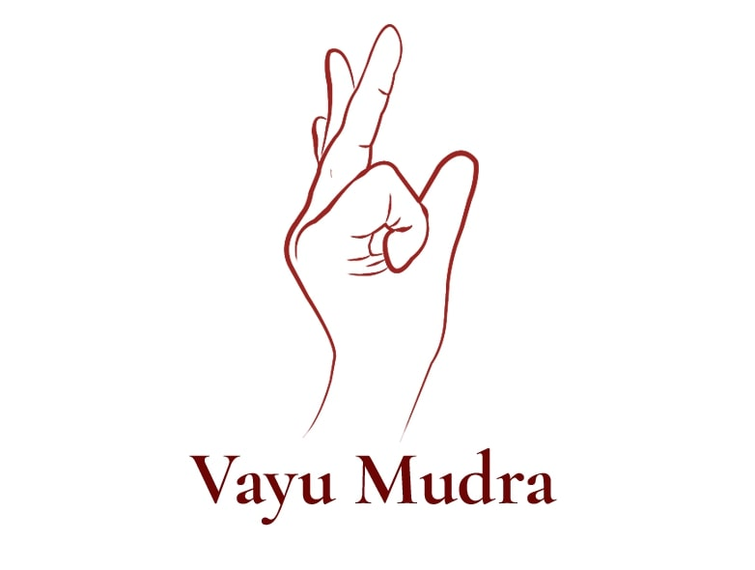

Slide 15
Dhyana Mudra
This is referred to as the ‘concentration mudra.’ For Dhyana Mudra bring your right hand above your left hand. Rest your right hand over the left hand. Bring the tips of your thumbs together and keep the fingers together. The fire element is connected via the thumbs and the other elements are at rest.
This mudra engages the intellect and calms the mind. Dhyana Mudra is a renowned hand mudra for meditation, with many iconic pictures and statues of Lord Buddha in Dhyana Mudra.

Slide 16
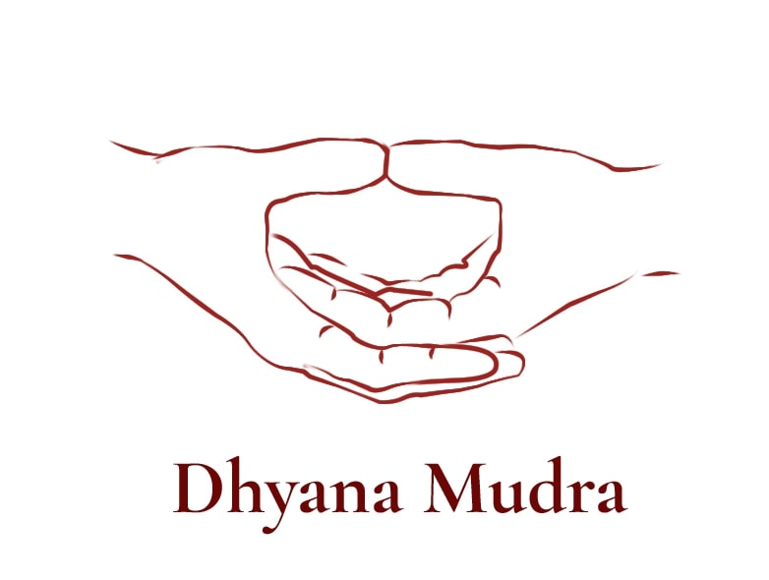

Slide 17
Apaan mudra
Join the tip of the thumb with the tips of middle and ring fingers, keeping the other fingers straight. This helps individuals who have urinary tract problems , reduces constipation, and purifies the body of harmful substances.

Slide 18
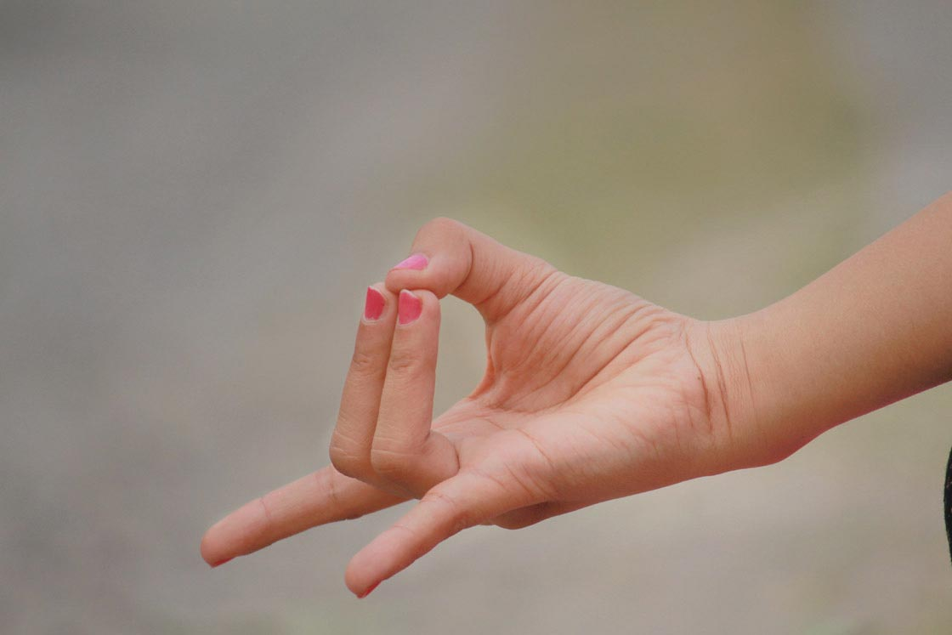

Slide 19
Prana Mudra
Join the tip of the thumb with tips of your little and ring fingers, and keep the other two fingers straight. This mudra balances the root chakra and infuses pranic energy into your body. It is also beneficial for many diseases; it improves vision and mental clarity.

Slide 20
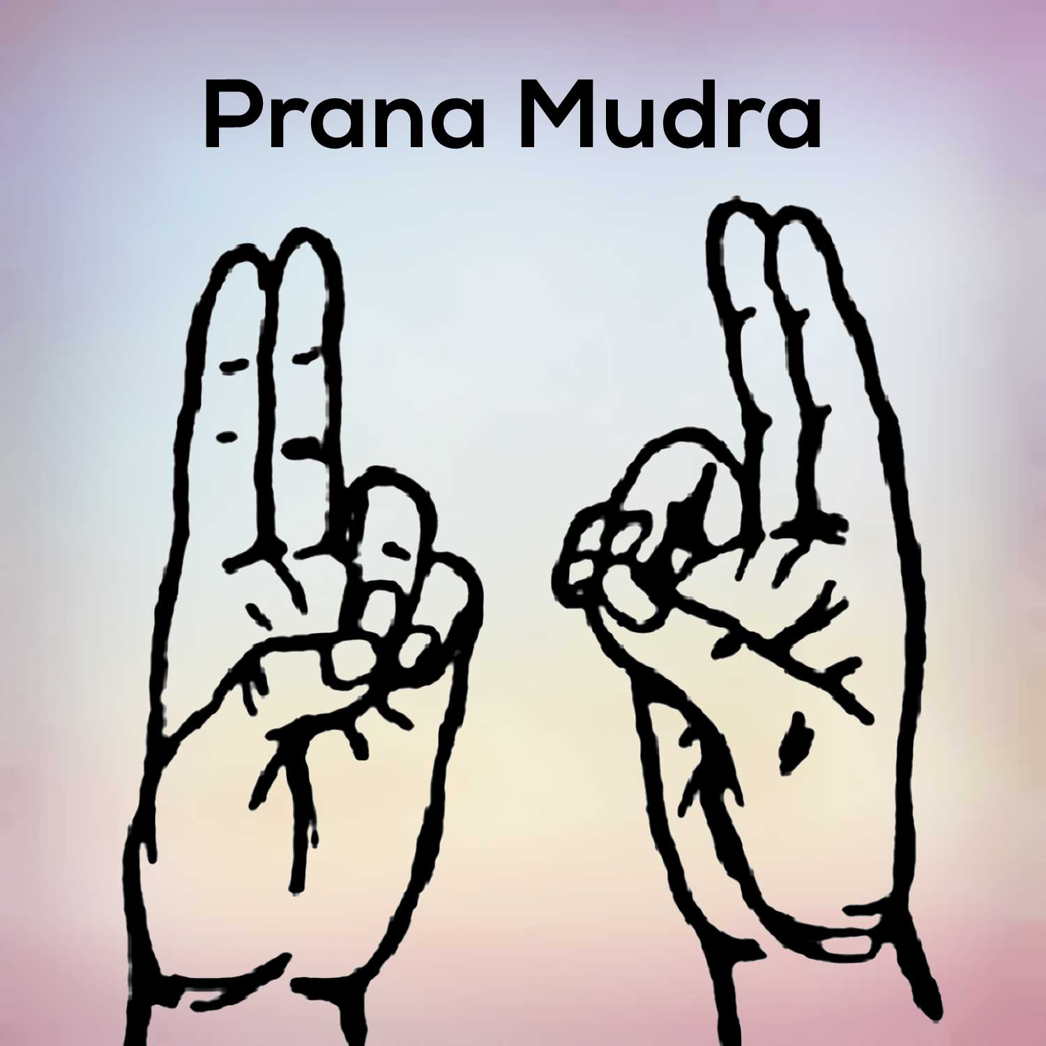

Slide 21
Apaan vaayu mudra
Join the tip of the thumb with the tips of the middle and ring fingers, while the index finger [turned inside] rests on the root of the thumb. Let the little finger remain extended. This posture is said to work like a “fire-fighting aid” in the event of a heart attack.

Slide 22
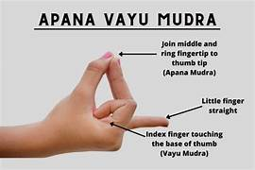
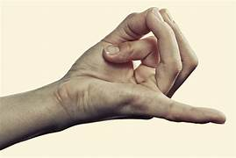

Slide 23
Shunya mudra
The middle finger is lowered into the base of the thumb and is covered by the thumb, while the other fingers remain extended. This is good for ear afflictions, listening and speech difficulties.

Slide 24
